Slide 1

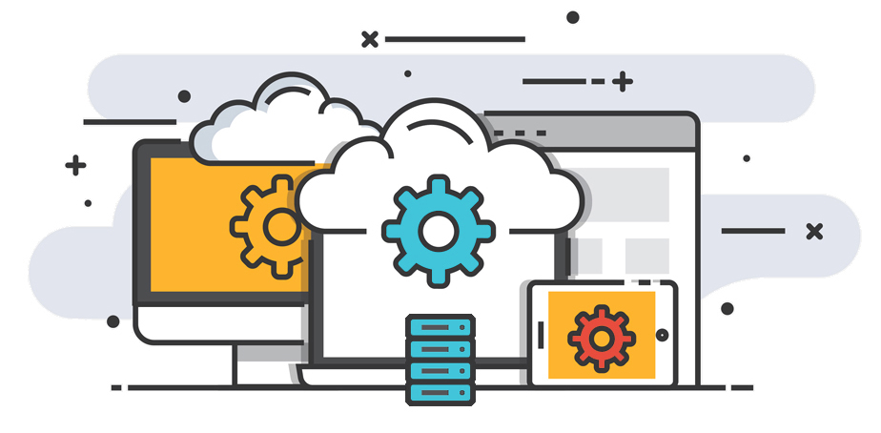
Premium API Partners Mapping

Slide 2

Nexelus and Trade Desk (TTD) Hierarchy
Vendor Spend from Placements
Package/Placement
Media plan
Buying
IOs create a separate TTD Campaign
TTD
Insertion Order
Flighting
TTD Campaign
Each Media plan can have multiple TTD Campaigns
Each Package/Placement can be used to create separate IOs OR one single IO
Campaign created under selected account
Delivery
TTD
Delivery Override
TTD Delivery is at IO level
Pulled every night via API
Delivery
Secondary pull previous month at month end
Raw delivery
Based on Performance report

Slide 3
Creating a TTD Campaign
1- To sync with TTD an IO will need to be created. Select the TTD line and Create IO.
Note that each Package/Placement can create a separate IO or multiple Package/Placements can be grouped together to create one IO.
If the Trade desk campaigns are required by Month/Quarter then the Package/Placements should also be set by Month/Quarter.
2- After the TTD IO is created. Please make sure that the AdServer Acct. you want to sync to is the one showing up on IO. It defaults from client profile. Then select the IO and click on the Create TTD Campaign(s)
3- In the first step of the TTD Campaign creation, you can name the TTD Campaign. By default it will be the Media Plan name. After you’ve named it, click next.

Slide 4
Flighting
4- In the second step, you can define the flight creation manually by clicking on “New Line” or you can have the system generate the flight by month, week or 1 one line (Media Plan Flight(s)) by clicking on the “Generate Schedule” drop down.
Tip: You can always revise the budget flight by reselecting the IO and click on the “Revise TTD Campaign(s)”.

Slide 5
Nexelus and AdWords Hierarchy
Vendor Spend from Placements
Package/Placement
Media plan
Buying
AdWords
Insertion Order
Multiple IOs can feed into single BO
Google Budget Order
Same Media plan can have multiple Budget Orders
Each Package/Placement can be used to create separate IOs OR one single IO
BO created under Customer account (CID)
Delivery
AdWords
Delivery Override
Pulled every night via API
Delivery
Secondary pull previous month at month end
Raw delivery
Based on AdWords Performance report

Slide 6
Creating a AdWords Budget Order
1- To sync with AdWords an IO will need to be created. Select the Google line and Create IO.
Note that each Package/Placement can create a separate IO or multiple Package/Placements can be grouped together to create one IO.
If the Budget Orders are required by Month/Quarter then the Package/Placements should also be set by Month/Quarter.
One or More IOs can feed into the same Budget Order
2- After the BO is created, Please make sure that the AdServer Acct. you want to sync to is selected correctly. It will default from client profile but can be changed on IO level. Then select the IO and click on the Create BO
3- In the first step of the BO creation, you can name the BO. By default it will be the Media Plan name.

Slide 7
Nexelus and Facebook Hierarchy
Vendor Spend from Placements
Package/Placement
Media plan
Buying
Facebook
Insertion Order
Each IO can only create one Campaign
Facebook Campaign
Each Media plan can have multiple Facebook Campaigns
Each Package/Placement can be used to create separate IOs OR one single IO
Campaign created under selected account
Delivery
Facebook
Delivery Override
Pulled every night via API
Delivery
Secondary pull previous month at month end
Raw delivery
Based on Performance report

Slide 8
Nexelus and BING Hierarchy
Vendor Spend from Placements
Package/Placement
Media plan
Buying
BING
Insertion Order
Each IO can only create one Campaign
BING IO
Each Media plan can have multiple BING IOs
Each Package/Placement can be used to create separate IOs OR one single IO
Campaign created under selected account
Delivery
BING
Delivery Override
Pulled every night via API
Delivery
Secondary pull previous month at month end
Raw delivery
Based on Performance report

Slide 9
Nexelus and Twitter Hierarchy
Vendor Spend from Placements
Package/Placement
Media plan
Buying
Twitter
Insertion Order
Each IO can only create one Campaign
Twitter IO
Each Media plan can have multiple Twitter IOs
Each Package/Placement can be used to create separate IOs OR one single IO
Campaign created under selected account
Delivery
Twitter
Delivery Override
Pulled every night via API
Delivery
Secondary pull previous month at month end
Raw delivery
Based on Performance report

Slide 10
Nexelus and DV360 Hierarchy
Vendor Spend from Placements
Package/Placement
Media plan
Buying
DV360
Insertion Order
Each IO can only create one Campaign
DV360 IO
Each Media plan can have multiple DV360 IOs
Each Package/Placement can be used to create separate IOs OR one single IO
Campaign created under selected account
Delivery
DV360
Delivery Override
Pulled every night via API
Delivery
Secondary pull previous month at month end
Raw delivery
Based on Performance report

Slide 11
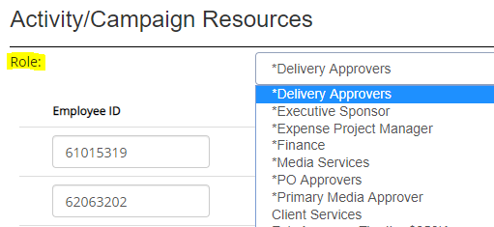
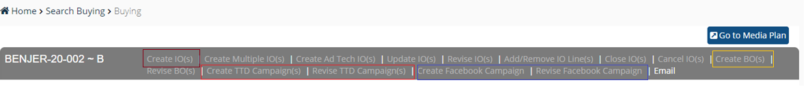
Who can create FB/TTD/BING/DV360/Twitter Campaign OR Google BO
Permission
Person should be tagged on Project/Activity resources under any role
User group should have rights

Slide 12
Delivery
Delivery from Premium platforms comes into Nexelus every ET night
A secondary pull is done at the end of each month for the full previous month.

Slide 13
Revisions – Optimizations / Change in Budget
Optimizations or change in Budget results in changing, adding or reducing Vendor spend (placements)
Revise IO to reflect the changes on Placements
Revise Trade desk or Facebook Campaign, Google Budget Order from Buying
NOTE: Making any changes directly in API partner’s platform will not reflect in Nexelus. All changes have to go from Nexelus into the API partner platforms.

